Slide 1

CROSS VALIDATION

Slide 2
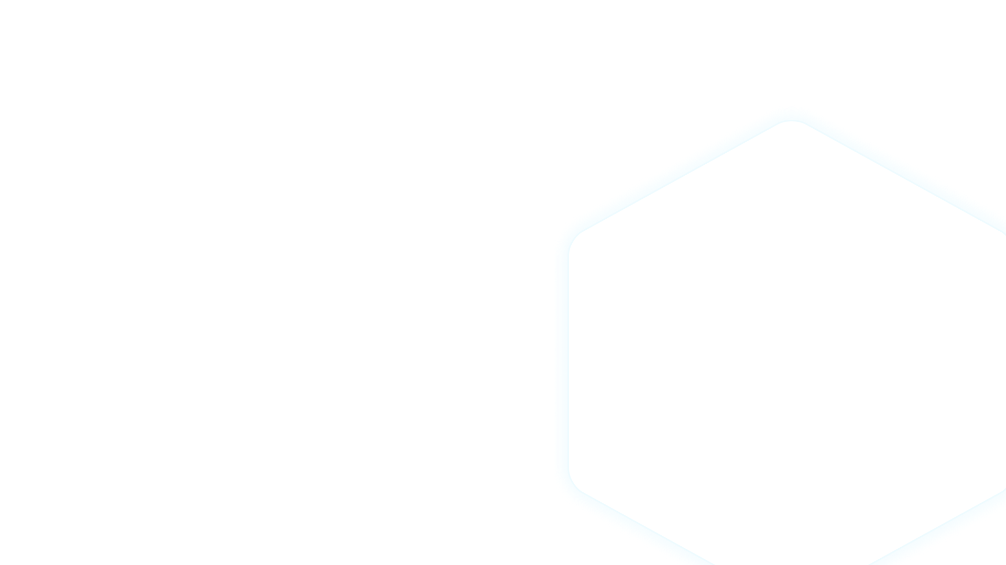

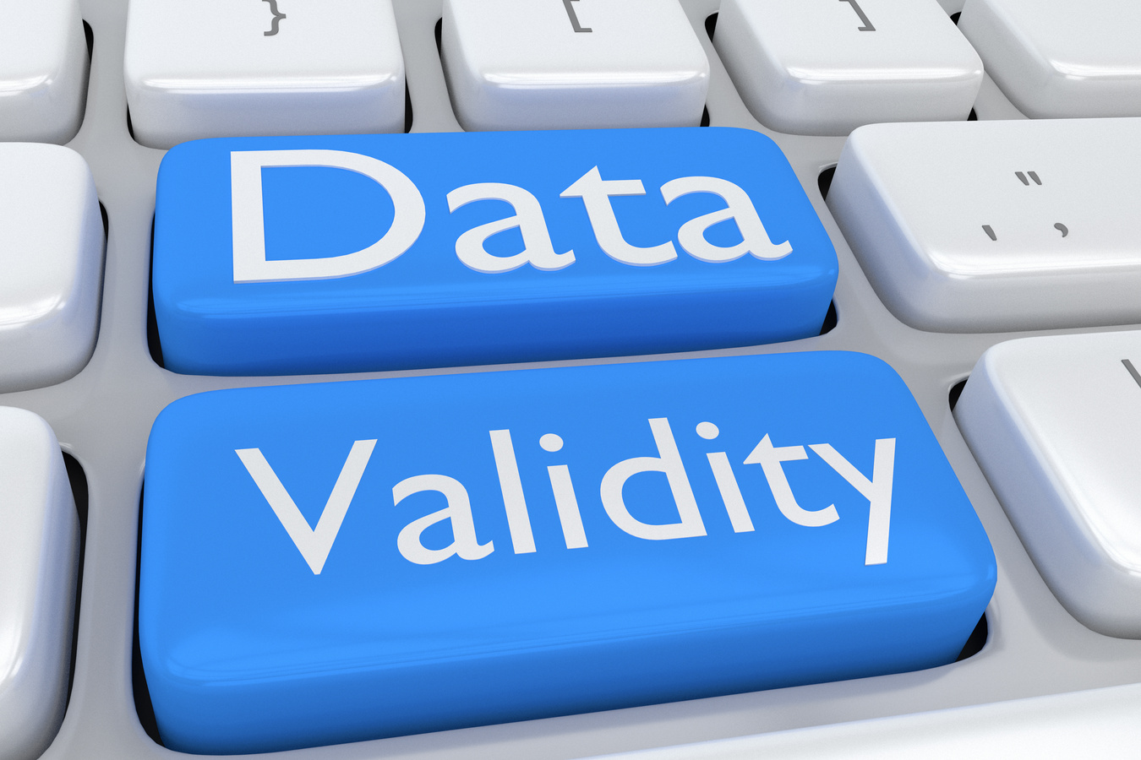

CROSS VALIDATION
Just to make the process more confusing!
Currently we've learnt that the train-test split is performed in a random way.
But are we leaving information on the table? How do we know a super representative point is being placed in the test dataset thus not allowing our algorithm to "learn"?
This is where Cross Validation comes in
Cros Validation is the process of performing several different test-train splits
Data Squad | Supervised Learning

Slide 3

CROSS VALIDATION
Currently we've learnt that the train-test split is performed in a random way.
But are we leaving information on the table? How do we know a super representative point is being placed in the test dataset thus not allowing our algorithm to "learn"?
This is where Cross Validation comes in
Cros Validation is the process of performing several different test-train splits
Data Squad | Supervised Learning

Slide 4
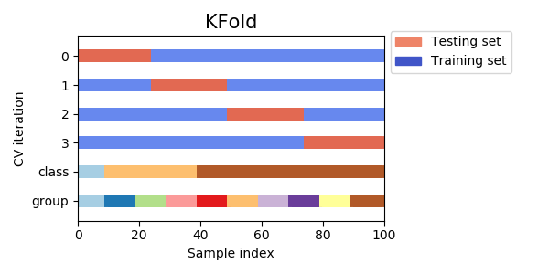
CROSS VALIDATION
This is the simplest Cross Validation technique whereby data is split into k times into different Test-Train splits always preserving the length of each
Data Squad | Supervised Learning

Slide 5
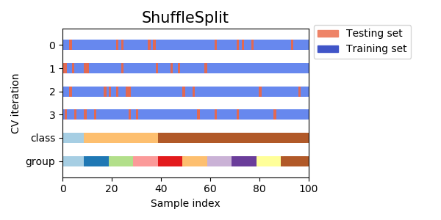
CROSS VALIDATION
Shuffle Split Cross Validation
Performing a shuffled split further ensures more randomness is created when performing the split
Data Squad | Supervised Learning

Slide 6
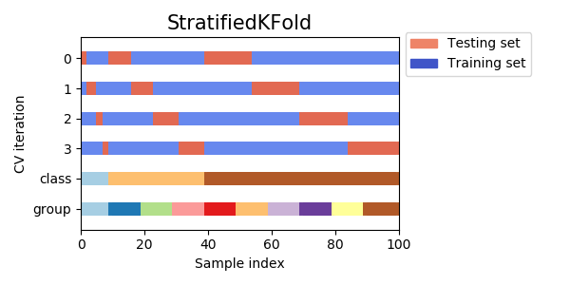
CROSS VALIDATION
Stratified KFold
Whenever you have a severe class imbalance you may want to perform stratified sampling: you create your splits always preserving the same ratio of each class types (1/10)
Data Squad | Supervised Learning

Slide 7

CROSS VALIDATION
How about the train-testing process for time series data?
Consider the problem if we used K-Fold
Data Squad | Supervised Learning

Slide 8
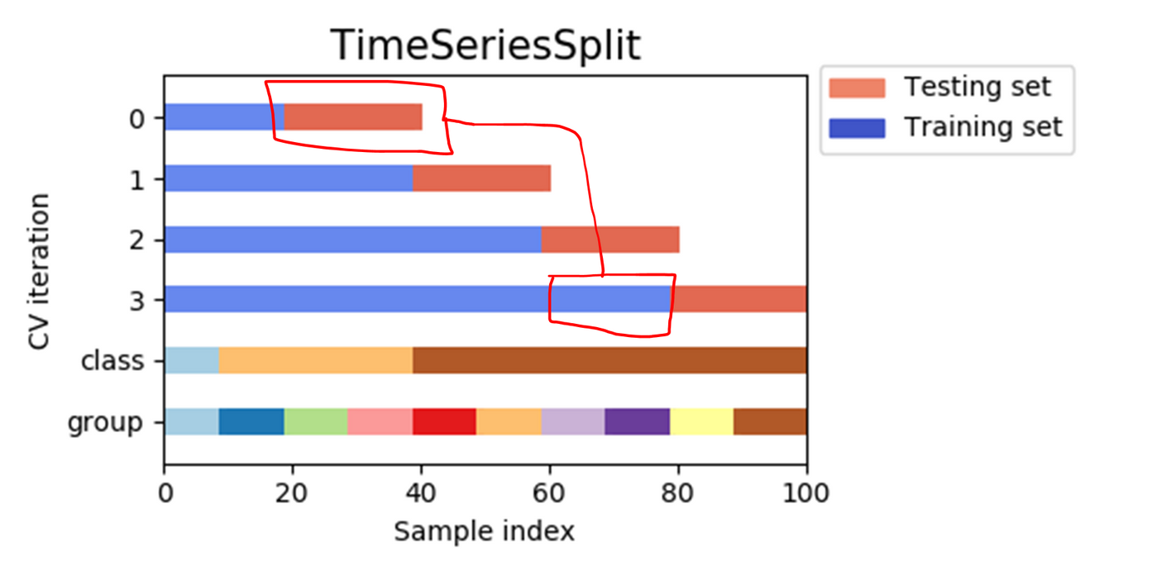
CROSS VALIDATION
How about the train-testing process for time series data?
Super common mistake that I see in using Time Series Data is to use data from the future to build a model to predict the past!!
Data Squad | Supervised Learning

Slide 9
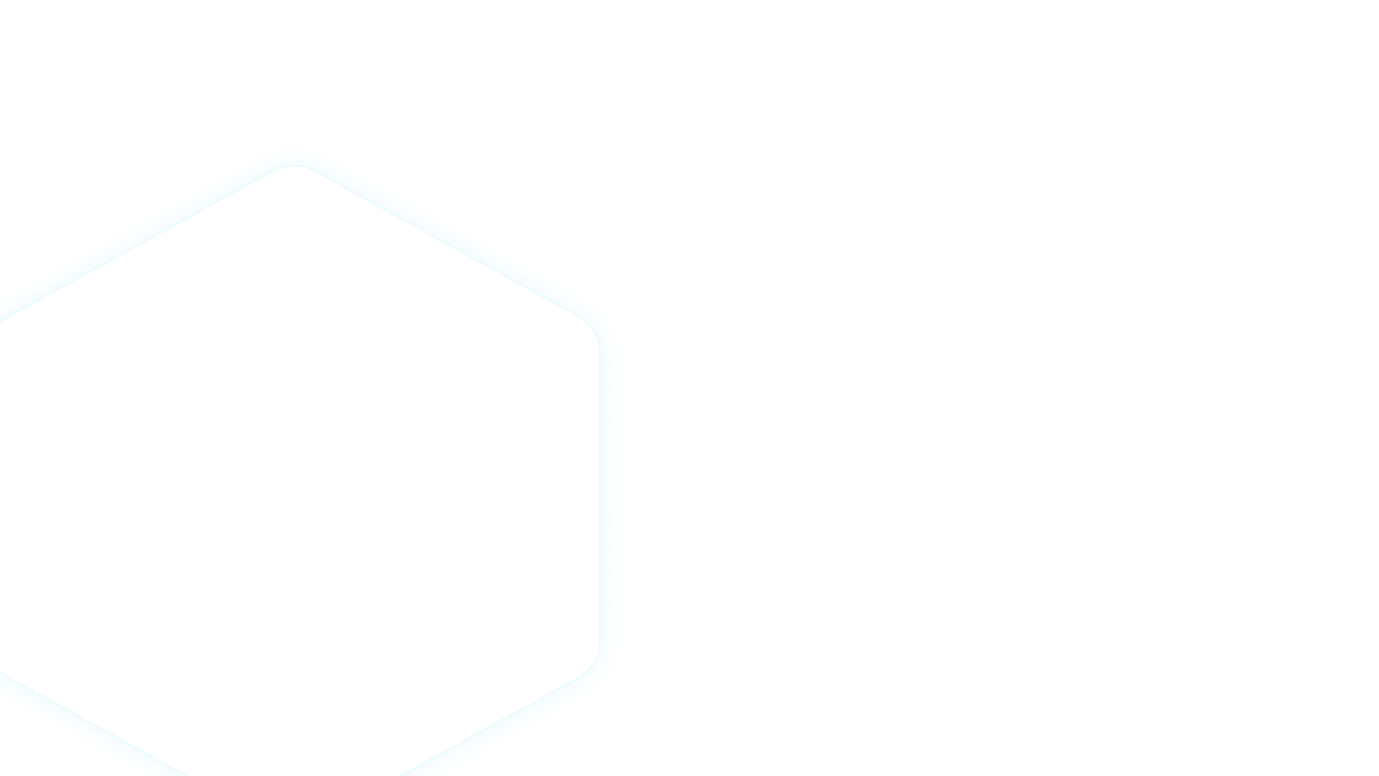
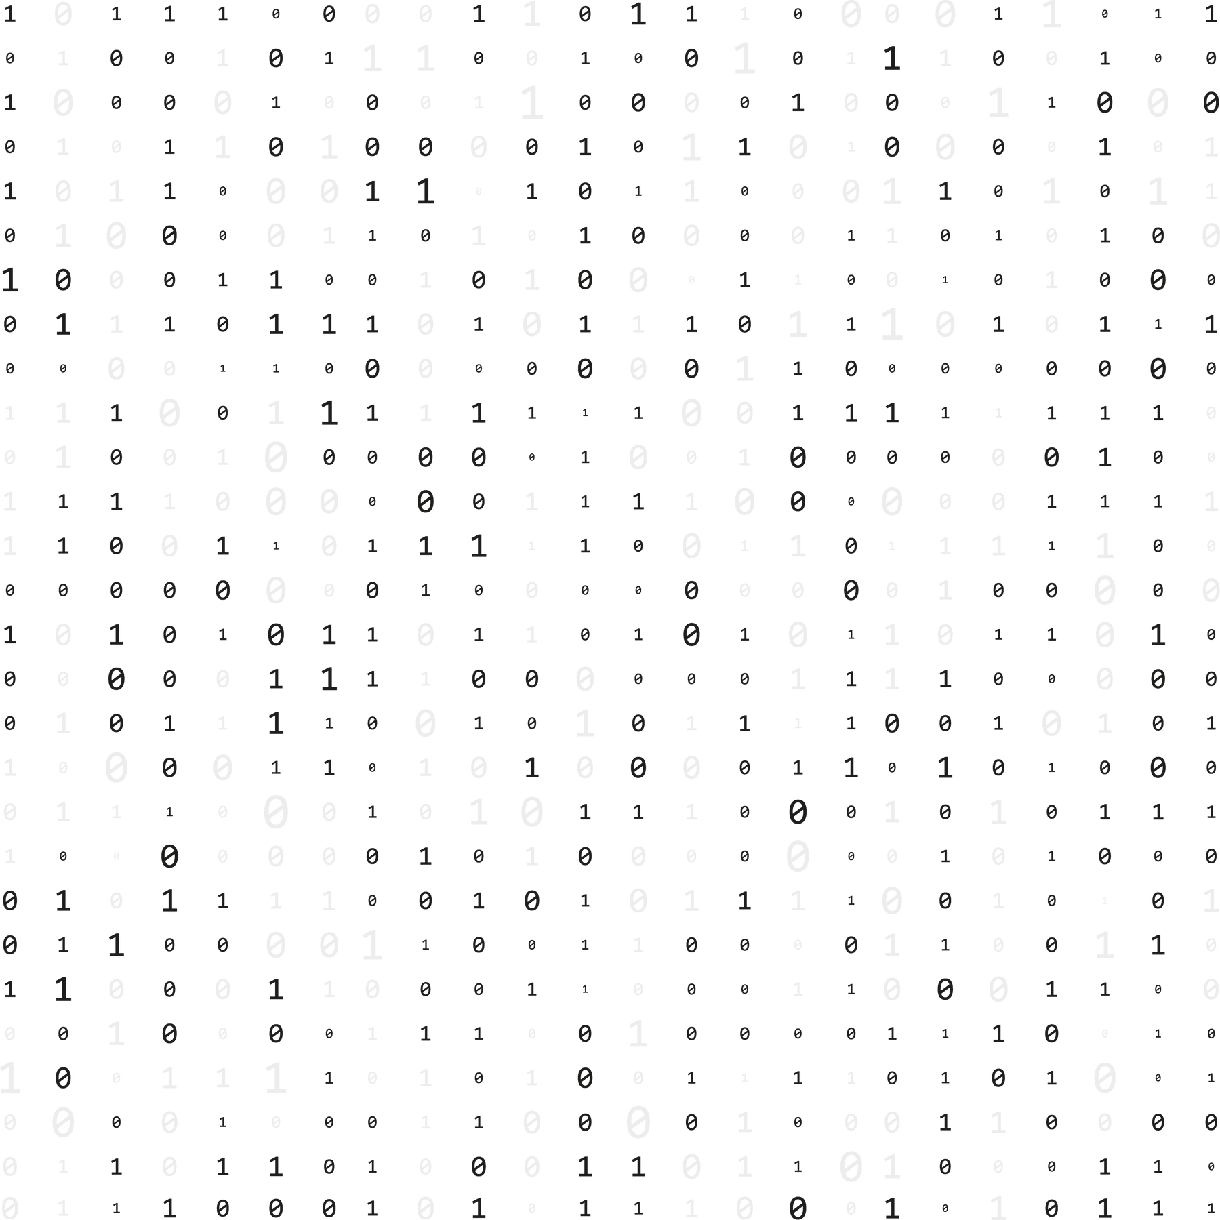

ANY QUESTIONS ?

